Slide 1
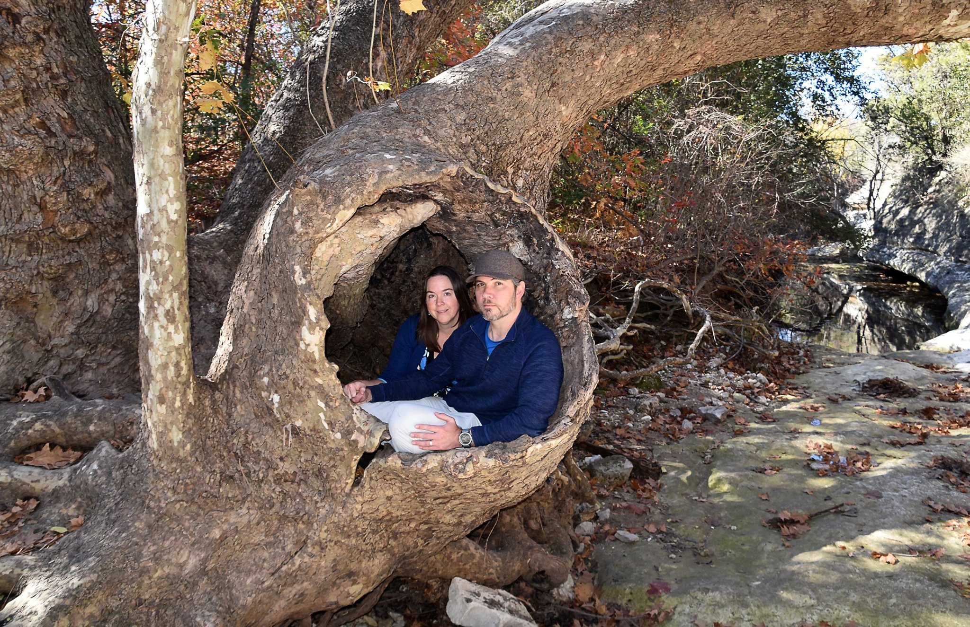
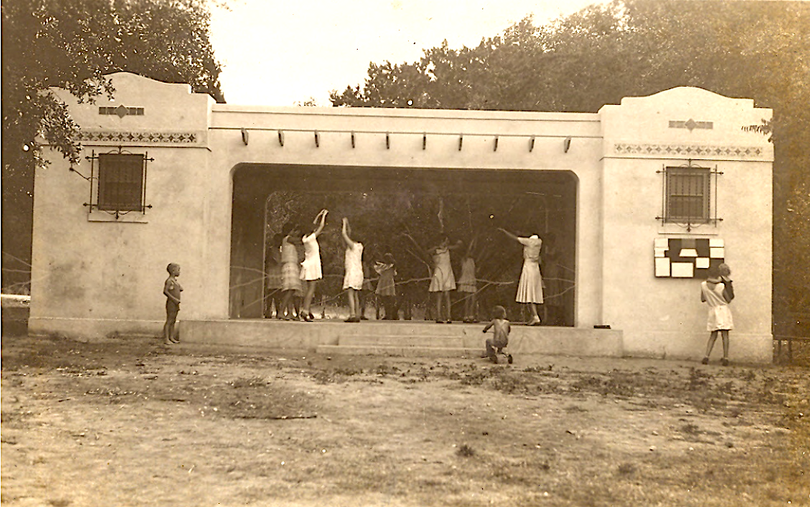
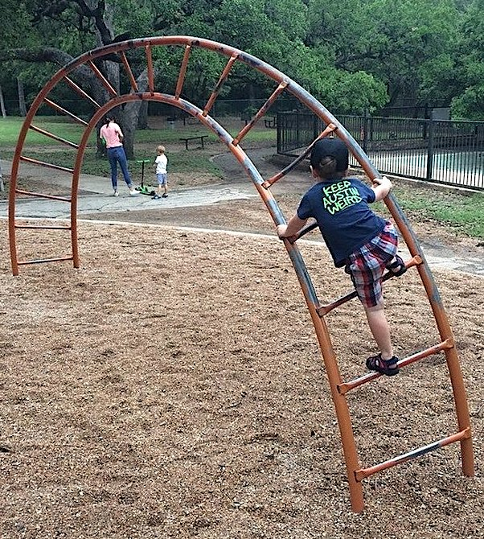
MAGIC PORTAL to LITTLE STACY PARK

Slide 2
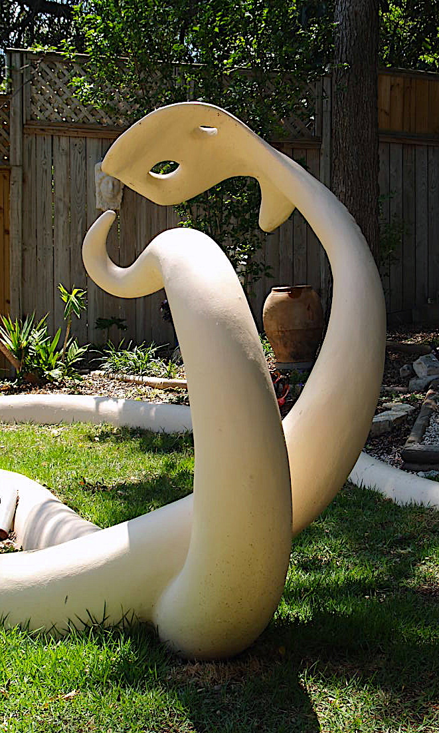
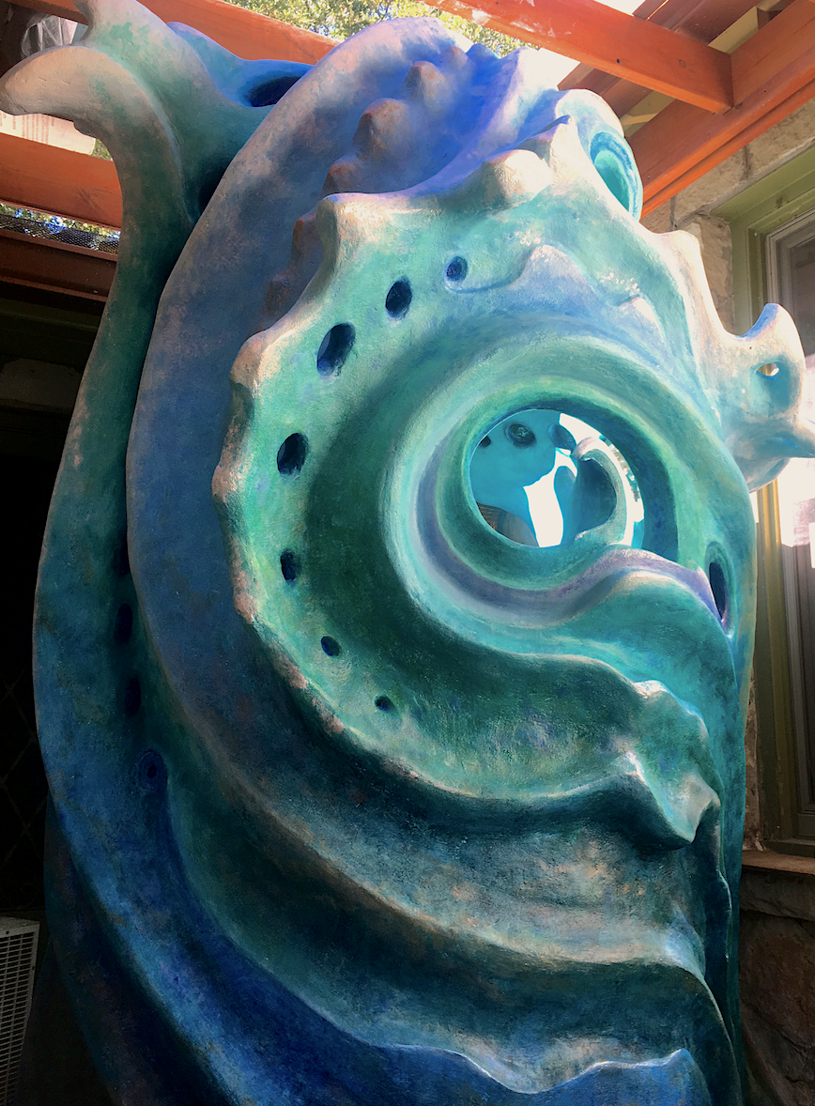
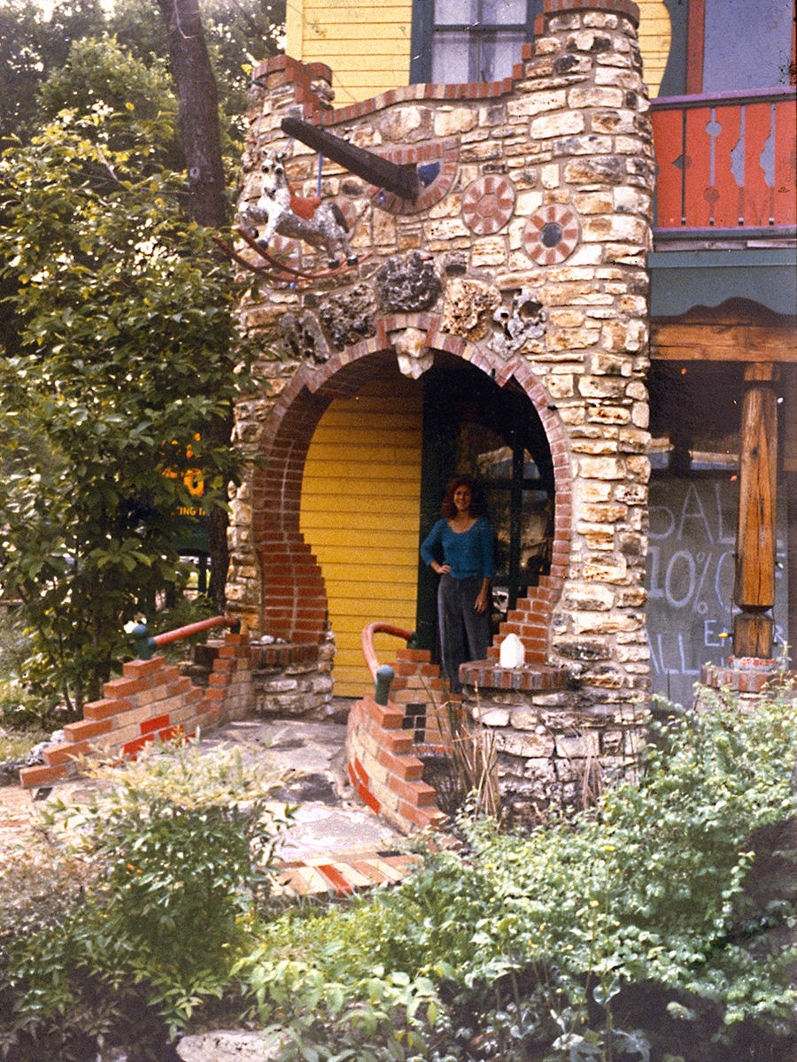
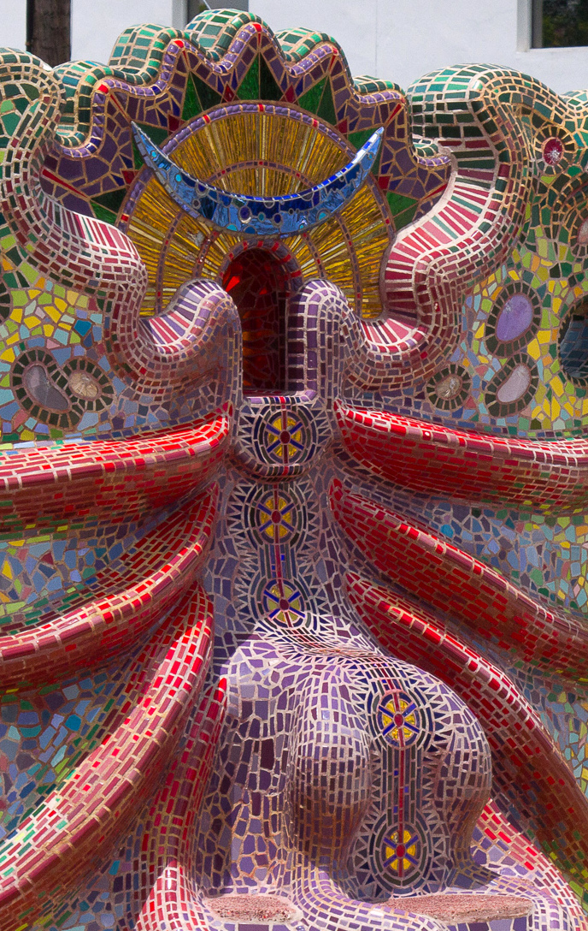
ENTER ANOTHER DIMENSION Setting the right mood
FUN & INVITING (Initial Goal of Pleasing Entrance)
Multiple sculptures offer different sequences & modes of entry for all ages
Wide range of 78704-style photo ops for singles, couples, families, groups
Sensual shapes and thoughtful arrangement invite play & choreography
INTERACTIVE (Community Engagement)
Novel opportunities for temporary flash art by local artists
Provisions for the addition of natural found objects
Indentions and connectors for wrapped, woven, & strung fiber art
Niches and holders for different sized sports balls
Natural slate for chalk writing, drawing, & coloring
Finials can be infilled
INTEGRATED WITH ITS SURROUNDINGS (Initial Project Goal of
Natural Setting Integration)
Flanking plantlike forms reference nearby windblown trees
Close proximity and similar materials to the Larry Monroe Bridge
Nestled within the leafy canopy of some of Stacy’s oldest trees
Easy visibility from Eastside Drive and Sunset Lane
MAGICAL (Initial Project Goal of Play)
Enchanted grove arrangement entices you in
Magic Portal heralds your arrival to a whole new world
Central fantasy “throne” allows you to rule the universe
Sparkle, rich color, and glowing translucencies please the eye
Fantastical, suggestive, unexpected forms set a magical vibe

Slide 3
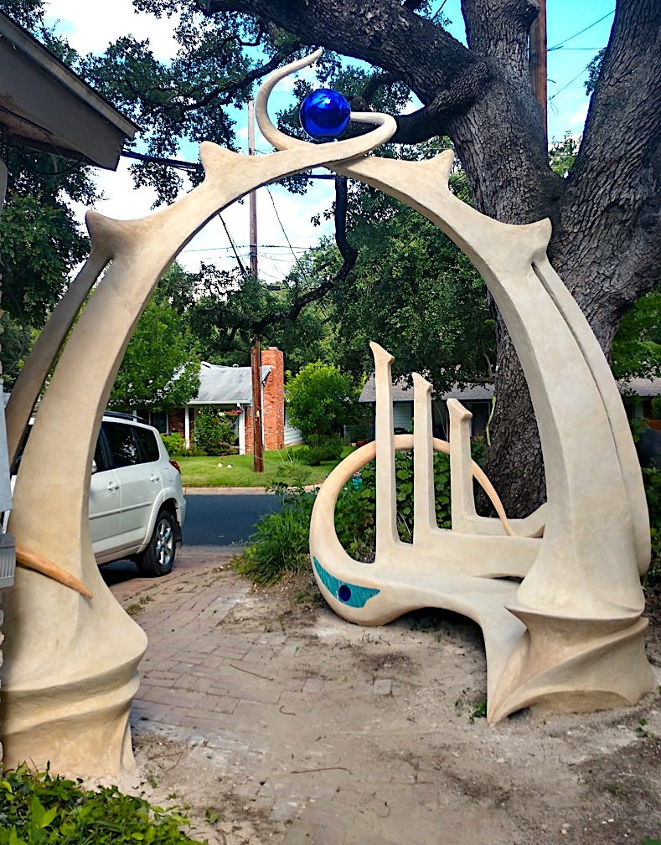
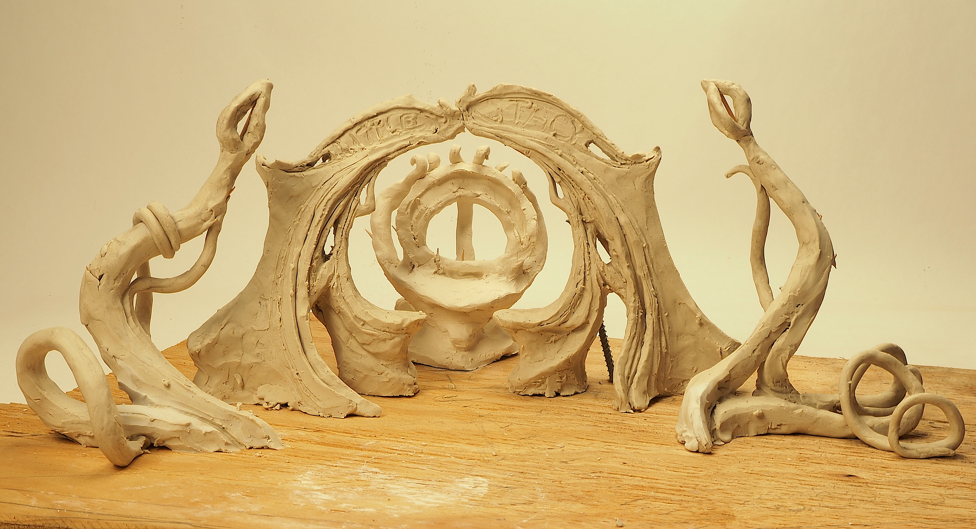
WORKING MODEL Showing relative locations of all the components

Slide 4
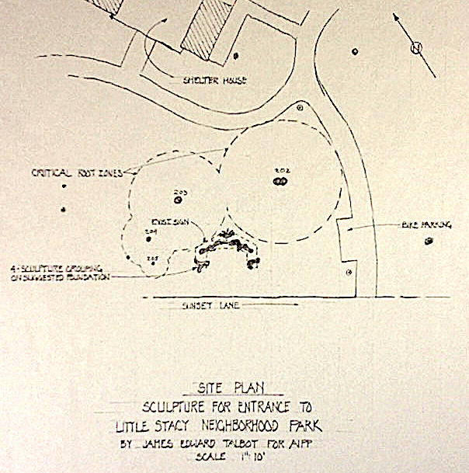
SITE PLAN & LOCATION Good visibility from Eastside Nestled in tree canopy Near Larry Monroe bridge Lots of foot traffic Replaces new park sign

Slide 5
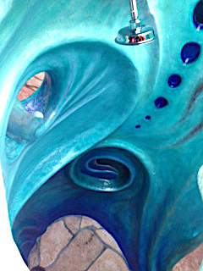
FOOTPRINT
Sculpture grouping &
Suggested foundation

Slide 6
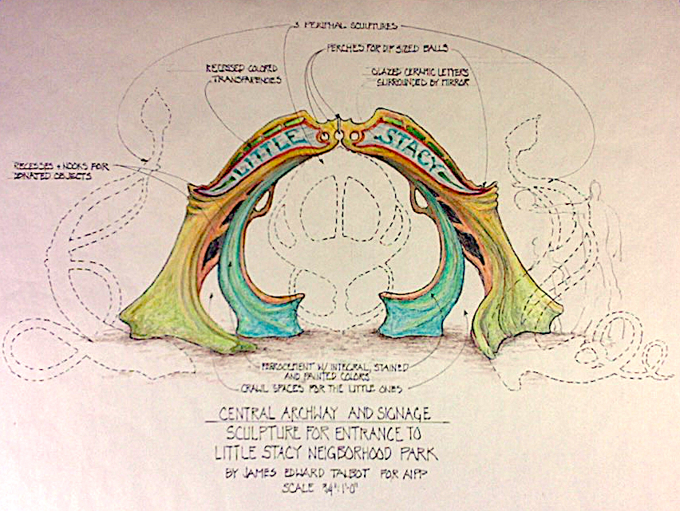
MAIN PORTAL Framed photo op Sitting spaces Can be added to Ceramic & mirror sign

Slide 7
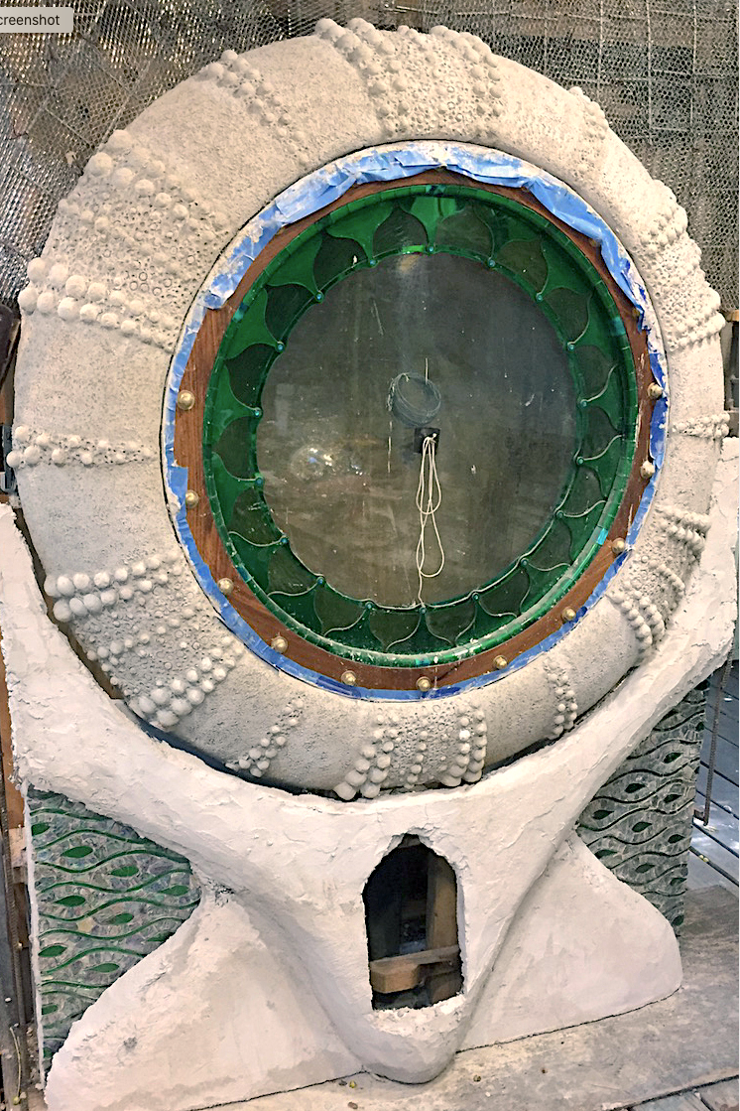
PERIPHERAL SCULPTURES Art-friendly Central throne Flanking plants

Slide 8
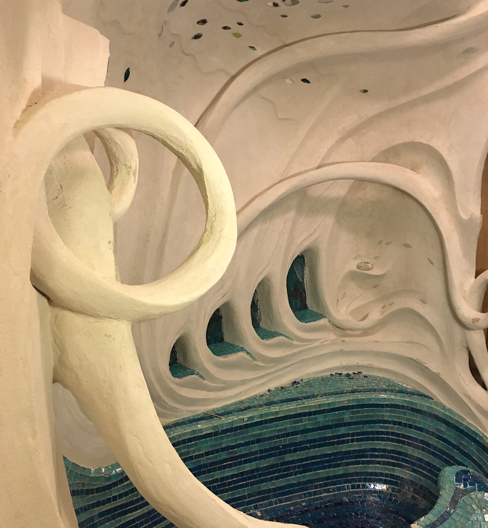
SIDE VIEW Throne behind portal Flanking plants in front Art-interactive

Slide 9
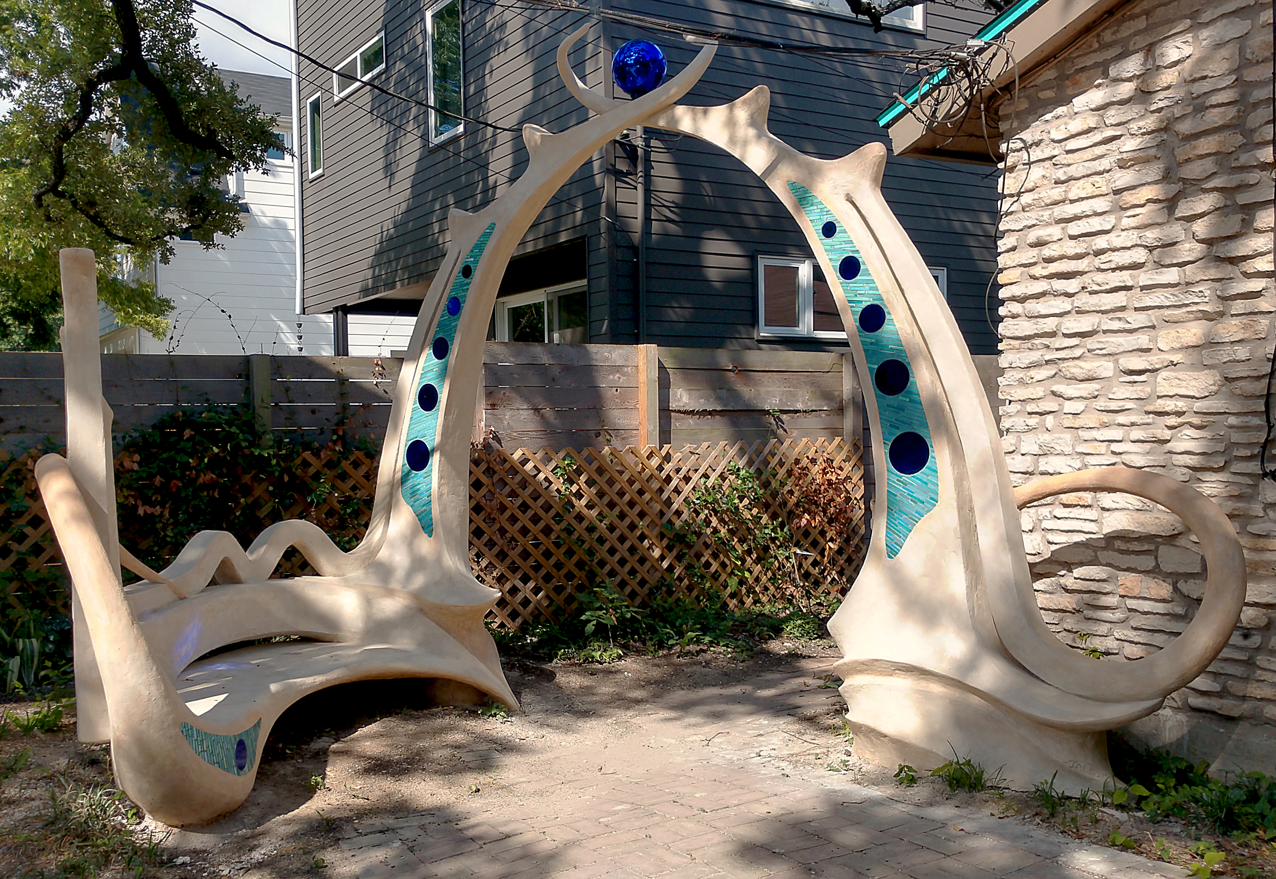
MAGIC PORTAL to LITTLE STACY PARK

